Slide 1
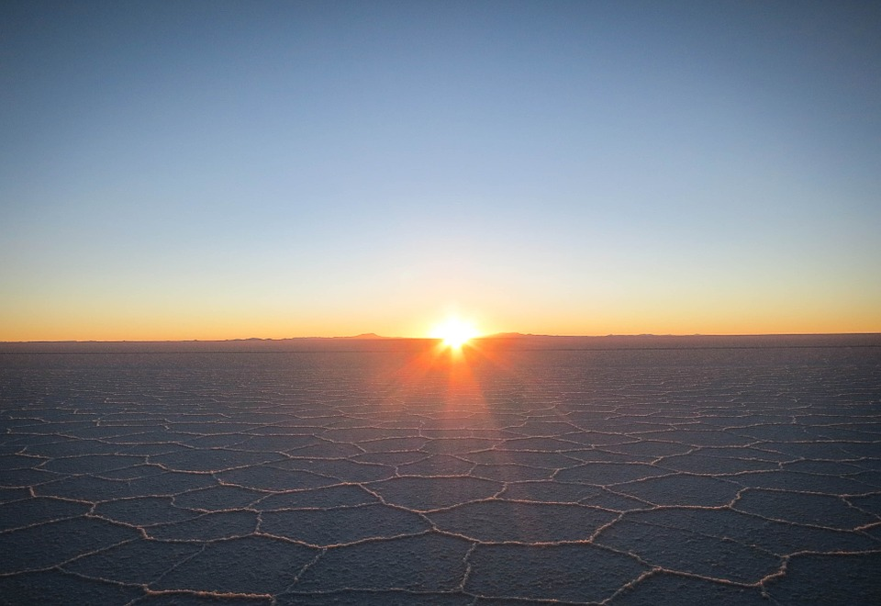

Extreme Living
Sci_Y06_U4_SS_ExtremeLiving

Slide 2
Living things rely on their environment to survive.
Some organisms have adaptations that help them to survive in particular environments.
Sci_Y06_U4_SS_ExtremeLiving

Slide 3
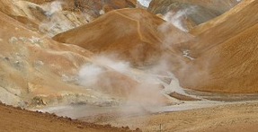
The heat is on
Life forms inhabit extremely hot environments such as hydrothermal and volcanic vents. They are unique because they can thrive on very little water, which is one of the components needed for growth.
Sci_Y06_U4_SS_ExtremeLiving

Slide 4
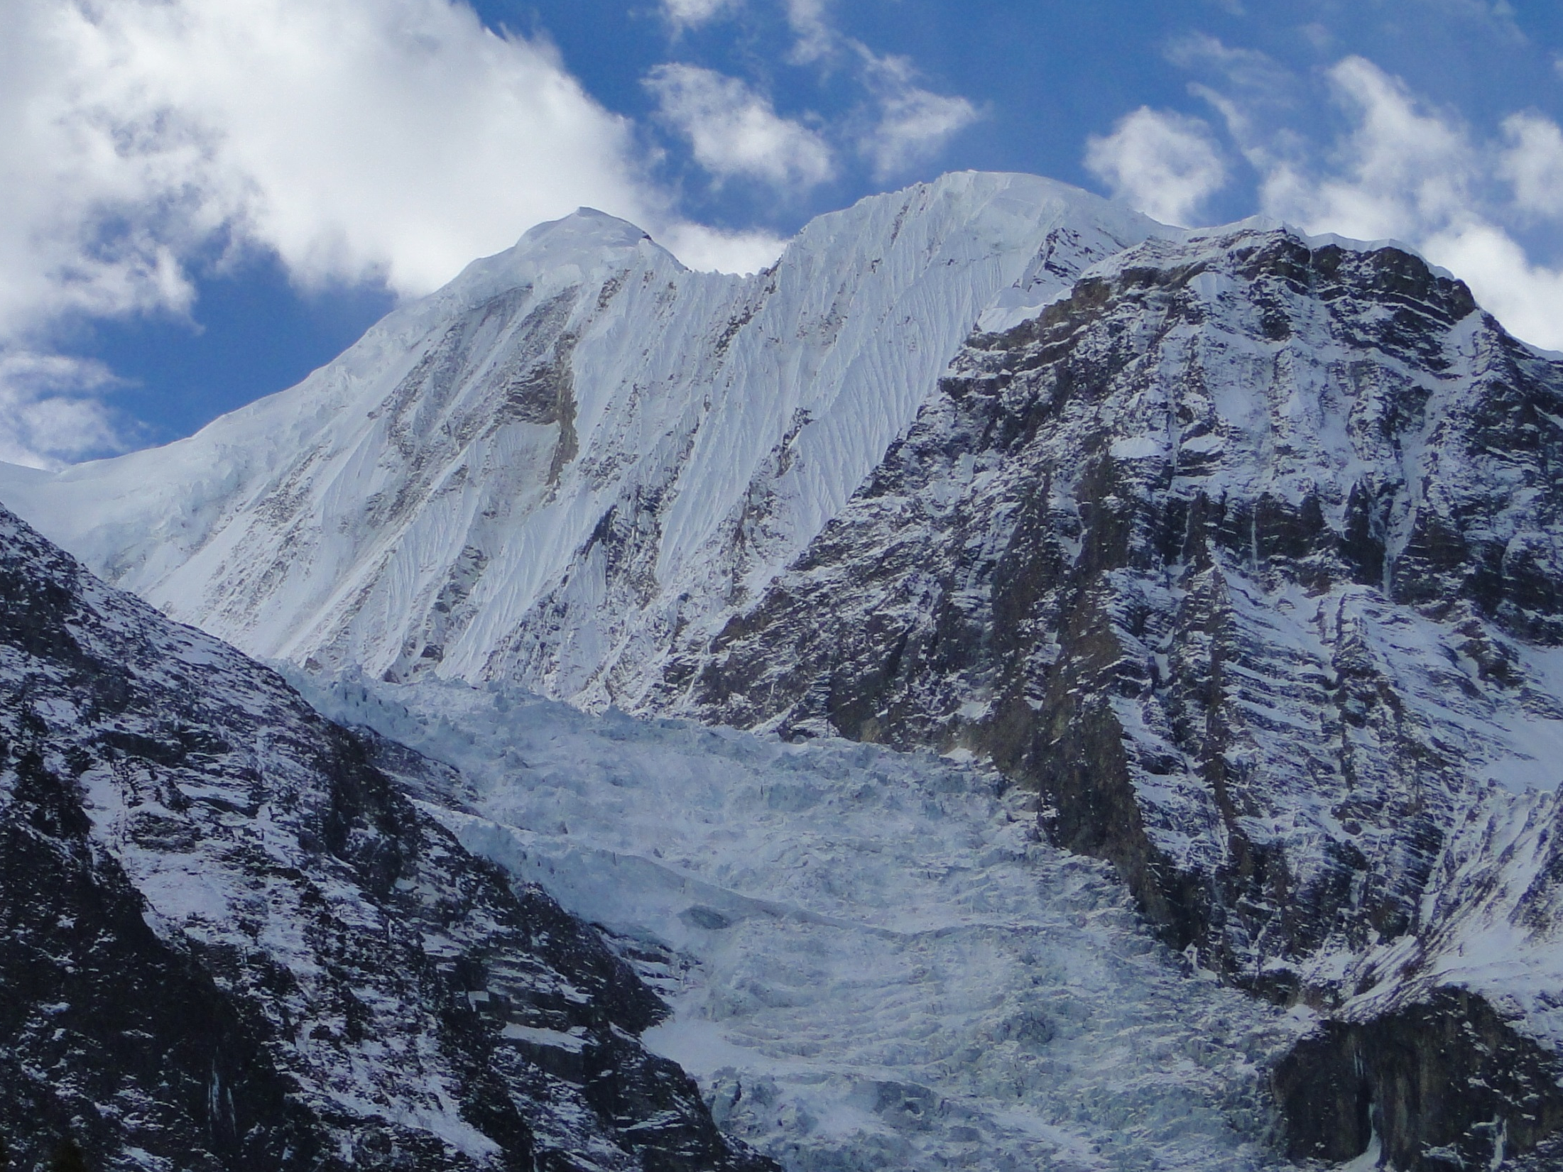
Cold as ice
Some organisms have features that help them survive in extremely cold environments, such as glaciers and icecaps.
Sci_Y06_U4_SS_ExtremeLiving

Slide 5
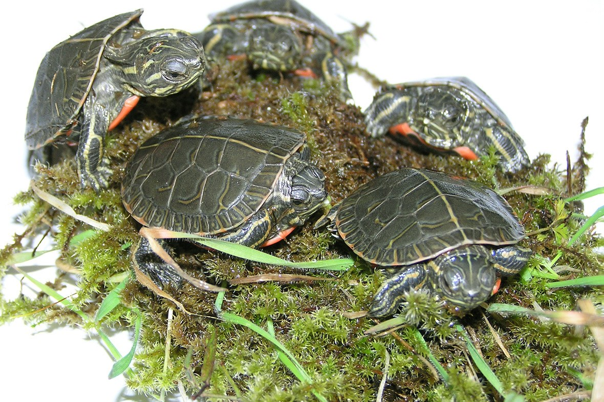


Some animals can freeze the water outside of their body cells to survive in extreme cold conditions. A small number of frogs, turtles and one snake do this to protect their cells during the winter. Other organisms freeze all of their body water.
Sci_Y06_U4_SS_ExtremeLiving

Slide 6
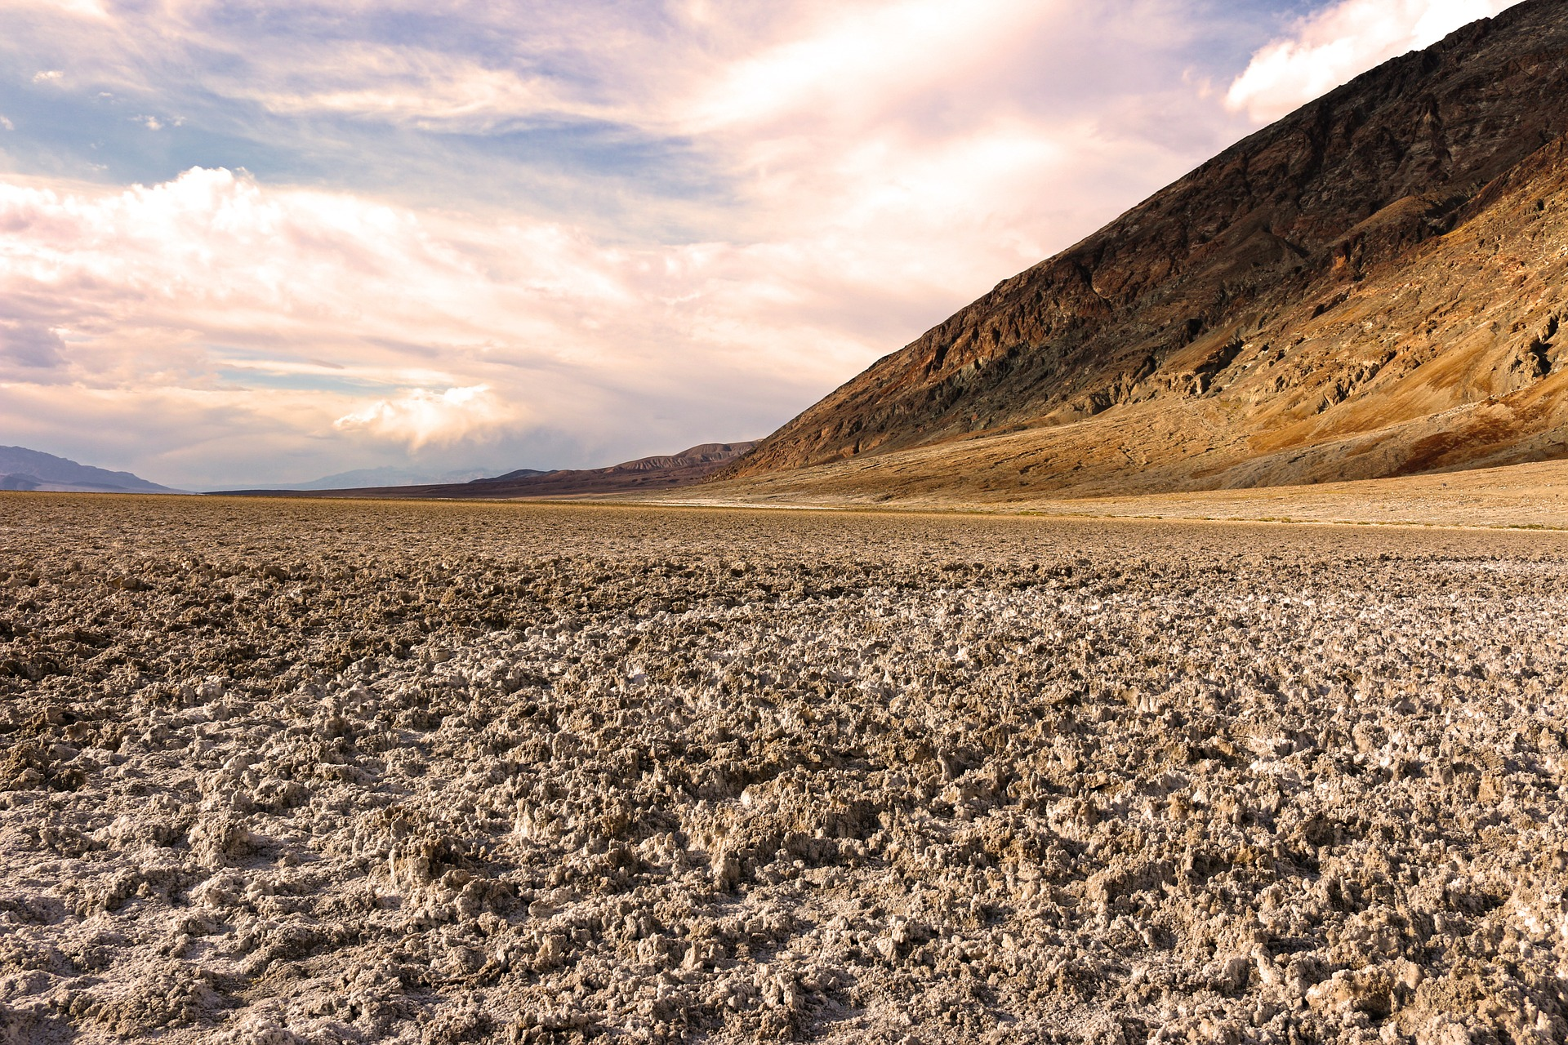
Way too salty
There are bacteria that have adapted to thrive in salty environments.
Sci_Y06_U4_SS_ExtremeLiving

Slide 7
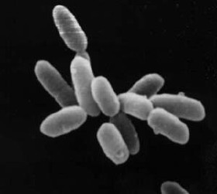
Halophilic bacteria thrive in salty environments.
Sci_Y06_U4_SS_ExtremeLiving

Slide 8
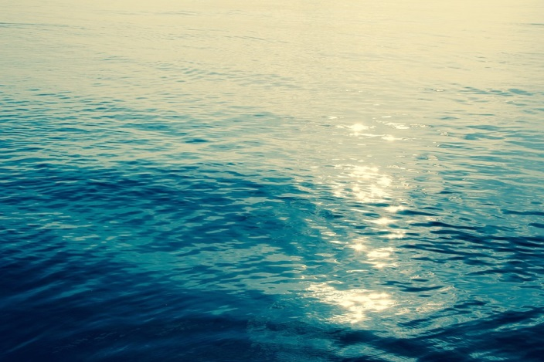
Zero O₂
Spinoloricus was discovered in 2010.
It lives deep on the floor of the Mediterranean Sea.
It is the first animal discovered that can survive and reproduce entirely without oxygen.
Sci_Y06_U4_SS_ExtremeLiving

Slide 9
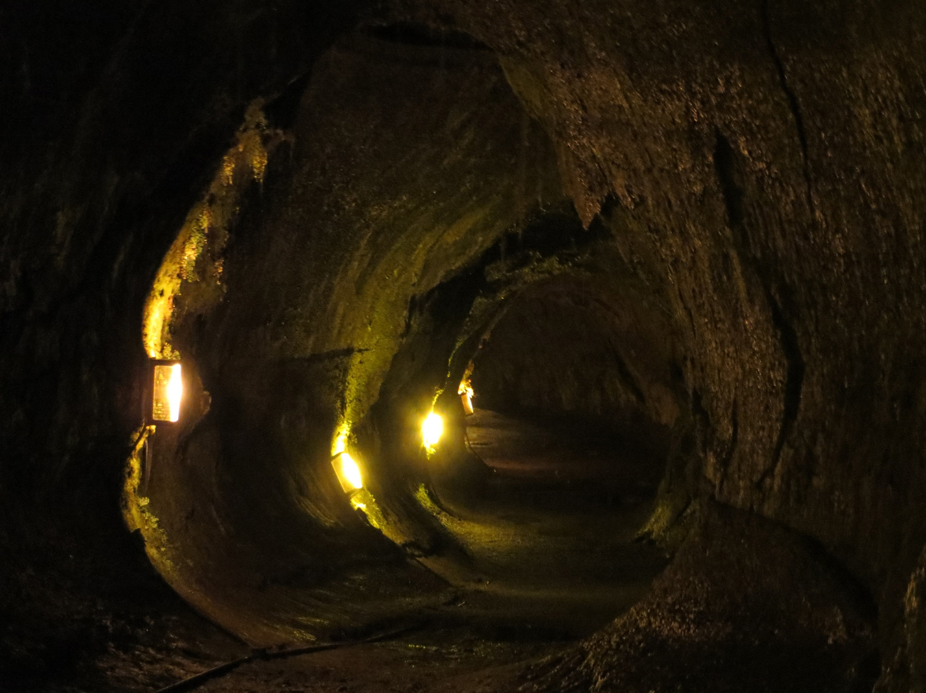
Love the dark
Most life on Earth depends on sunlight, but many living things thrive in darkness.
Many of these animals have adaptations like long limbs and well-developed senses that help them move and find food without light.
Sci_Y06_U4_SS_ExtremeLiving

Slide 10
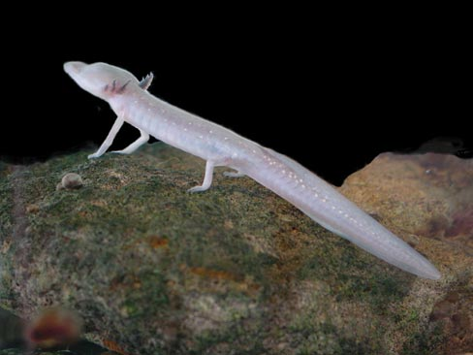
The Texas blind salamander lives in the constant darkness of caves.
It has no pigment in its skin and is virtually blind.
It has heightened senses of smell and hearing.
Sci_Y06_U4_SS_ExtremeLiving

Slide 11
Extremophiles also thrive in other environments
Polluted environment
Extreme pressure
High sugar concentration
Unusual habitats
Extreme radiation
Sci_Y06_U4_SS_ExtremeLiving

Slide 12
Extremophiles inhabit environments that would be harmful to most other life on Earth.
Sci_Y06_U4_SS_ExtremeLiving

Slide 13
Attributions
Slide 1 and 2 TravelCoffeeBook, 2014, Desert, https://pixabay.com/en/salt-lake-atacama-desert-hexagons-594606/
Slide 3 Charrier, T, 2010, Iceland, https://pixabay.com/en/iceland-desert-soufriere-volcanism-614279/ (cropped)
Slide 4 Tcy3282, 2010, Glacier, https://www.flickr.com/photos/59703310@N00/9928324424/in/photolist
Slide 5 Oregon Department of Fish and Wildlife, 2006, Western Painted Turtle, https://www.flickr.com/photos/odfw/5149516916/in/album-72157623092765619/ CC BY-SA 2.0 creativecommons.org/licenses/by-sa/2.0/
Slide 6 Esudroff, 2016, SaltFlats, https://pixabay.com/en/death-valley-badlands-salt-flats-1303573/
Slide 7 NASA, 2007, Halbacteria, https://en.wikipedia.org/wiki/Haloarchaea#/media/File:Halobacteria.jpg
Slide 8 Peggy und Marco Lachmann-Anke, 2015, Ocean, https://pixabay.com/en/rays-blue-dark-covered-ocean-1189782/
Slide 9 Yount, L. A, 2013, Lava tube, Hawaii, https://www.flickr.com/photos/136594255@N06/23271547744/in/photolist
Slide 10 Fries, J, 2007, Texas blind salamander, U.S. Fish and Wildlife Service, https://commons.wikimedia.org/wiki/File:Texas_blind_salamander.jpg
References
Website — Extremophiles and life beyond Earth (American Museum of Natural History) http://www.amnh.org/explore/news-blogs/q-as/extremophiles-and-life-beyond-earth
Website — Extreme life on Earth: 8 bizarre creatures (Livescience) http://www.livescience.com/13377-extremophiles-world-weirdest-life.html
Website — Life in extreme environments (National Space Society) http://www.nss.org/adastra/volume14/rothschild.html
Website — First oxygen-free animals found (BBC) http://news.bbc.co.uk/2/hi/sci/tech/8609246.stm
Website — Extremophilic microbes — Organisms living in extreme conditions (Biotech Articles) http://www.biotecharticles.com/Applications-Article/Extremophilic-Microbes-Organisms-Living-in-Extreme-Conditions-585.html
Sci_Y06_U4_SS_ExtremLiving

